Slide 1
Basic Concepts in Big Data

Slide 2
What is “big data”?
"Big Data are high-volume, high-velocity, and/or high-variety information assets that require new forms of processing to enable enhanced decision making, insight discovery and process optimization” (Gartner 2012)
Complicated (intelligent) analysis of data may make a small data “appear” to be “big”
Bottom line: Any data that exceeds our current capability of processing can be regarded as “big”

Slide 3
Why is “big data” a “big deal”?
Government
Obama administration announced “big data” initiative
Many different big data programs launched
Private Sector
Walmart handles more than 1 million customer transactions every hour, which is imported into databases estimated to contain more than 2.5 petabytes of data
Facebook handles 40 billion photos from its user base.
Falcon Credit Card Fraud Detection System protects 2.1 billion active accounts world-wide
Science
Large Synoptic Survey Telescope will generate 140 Terabyte of data every 5 days.
Biomedical computation like decoding human Genome & personalized medicine
Social science revolution
-…

Slide 4
Lifecycle of Data: 4 “A”s
Scattered
Data
Aggregation
Integrated
Data
Acquisition
Analysis
Log data
Knowledge
Application

Slide 5
Computational View of Big Data
Data Visualization
Data Access
Data Analysis
Data Understanding
Data Integration
Formatting, Cleaning
Storage
Data

Slide 6
Big Data & Related Topics/Courses
CS199
Human-Computer Interaction
Data Visualization
Databases
Information Retrieval
Machine Learning
Data Access
Data Analysis
Data Mining
Computer Vision
Speech Recognition
Data Understanding
Data Integration
Natural Language Processing
Data Warehousing
Formatting, Cleaning
Signal Processing
Many Applications!
Storage
Data
Information Theory

Slide 7
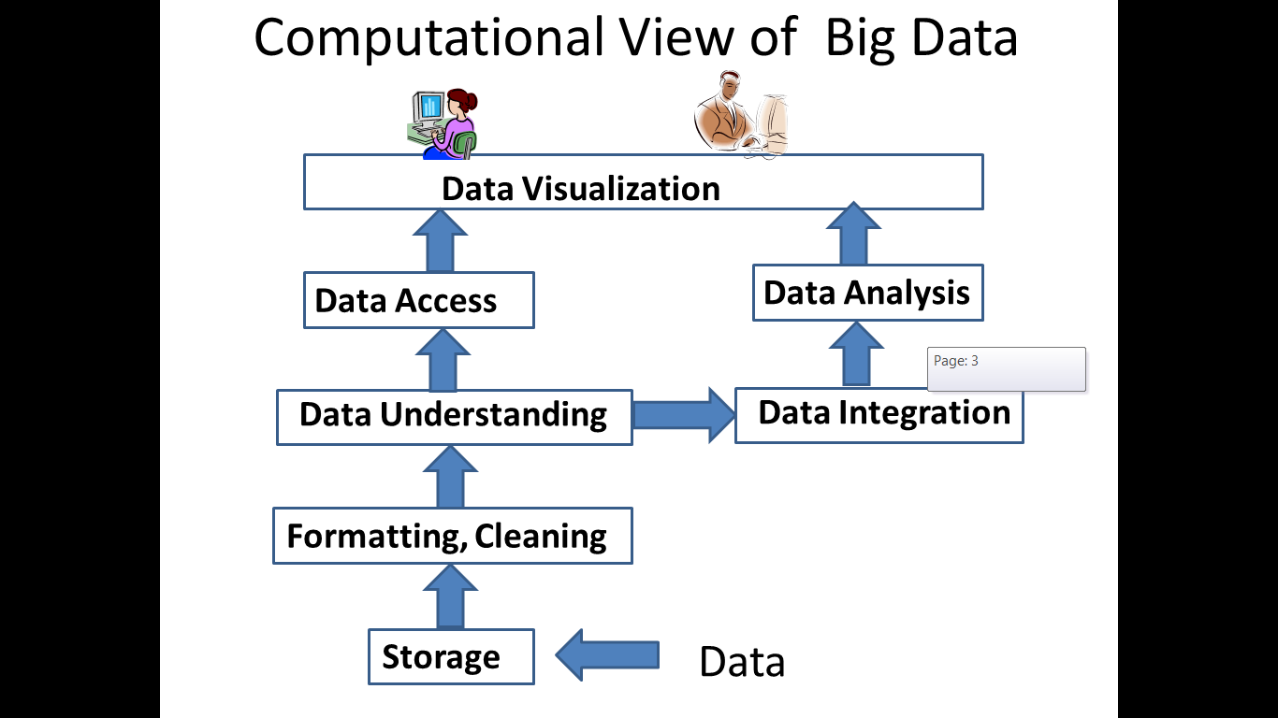
Some Data Analysis Techniques
Visualization
Classification
Predictive Modeling
Time Series
Clustering

Slide 8
Example of Analysis: Clustering & Latent Factor Analysis
Group M1
Group M2
 | Movie 1 | Movie 2 | … | Movie m
User1 | 3.5 | 4 |  | 5
User2 | 5 | 1
…
User n | 2 | 1 |  | 4
Group U1
Group U2

Slide 9
Example of Analysis: Predictive Modeling
Group M1
Group M2
 | Movie 1 | Movie 2 | … | Movie m
User1 | 3.5 | 4 |  | 5
User2 | 5 | 1
…
User n | 2 | 1 |  | 4
Group U1
=?
Group U2
Does user2 like movie m?
What rating is user2 likely going to give movie m?
(Binary) Classification
Regression

Slide 10
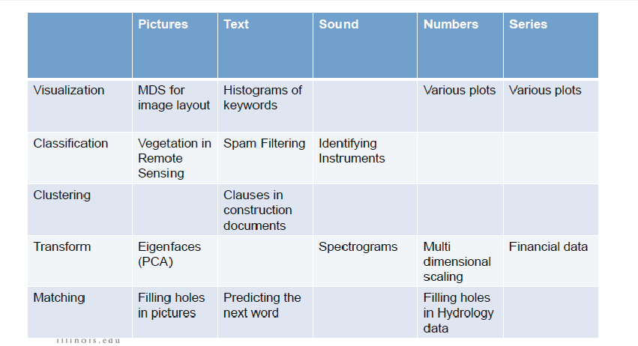
Some topics we’ll cover

